Slide 1
MICROSOFT MOVIE ANALYSIS
Final Project Submission

Slide 2
Final Project Submission
Student name: Eric Rono
Student pace: part time
Scheduled project review date/time: 3rd June 2024
Blog post URL

Slide 3
PROCESS FLOW
Project Overview
This project employs exploratory data analysis to extract valuable information for Microsoft's endeavor of establishing a new movie studio. By analyzing datasets from IMDB and Box Office Mojo, the project aims to provide recommendations on the most promising film genres, considering not only the total gross revenue but also the critical reviews and ratings.
The analysis evaluates the success and popularity of each genre through three key metrics: total gross income, critical response, and audience ratings. The findings suggest that Microsoft should concentrate its efforts on genres such as science fiction, adventure, animation, and action, as these genres have not only demonstrated higher total gross income but also garnered favorable critical reviews and high audience ratings.
By considering these factors holistically, Microsoft can increase its chances of producing commercially successful and critically acclaimed films that resonate with both critics and audiences alike, thereby establishing a strong presence in the competitive movie industry.

Slide 4
Business Problem
Microsoft, a tech giant, is venturing into original video content creation by establishing its own movie studio. However, lacking substantial film industry experience poses a challenge. To mitigate this, a comprehensive analysis of successful box office trends through exploratory data analysis becomes crucial. This analysis aims to uncover valuable insights to guide Microsoft's nascent movie studio in making informed genre and theme decisions. By leveraging data-driven insights, Microsoft can navigate the unfamiliar film industry terrain more effectively, increasing the likelihood of producing captivating and commercially successful films.
Key inquiries:
Analyzing box office gross, audience ratings, and domestic/foreign revenue trends across genres and release years provides actionable insights for Microsoft's movie studio. Identifying top-performing genres financially, rating correlations, and evolving market dynamics equips the studio head with intelligence to craft a content strategy maximizing success in the competitive entertainment landscape.

Slide 5
Data Understanding
I merged two datasets with a purpose of combining movie metadata with their corresponding reviews to enable comprehensive analysis. The movie_info dataset contains metadata about movies, including details such as: 1.Genre - The genre(s) of the movie.
2.Director - The director of the movie.
3.Theatre & dvd dates - dates on cinemas and dvd
4.Runtime - The runtime of the movie in minutes.
5.Currency - revenues collected from the movie

Slide 6
This dataset contains reviews of the movies, including details such as:
1.Review_id - Unique identifier for each review.
2.Reviewer - The name or identifier of the reviewer
3.Rating - The rating given by the reviewer (e.g., on a scale from 1 to 10).
4.review_text - The text content of the review.
5.publisher_date - The date when the review was written.

Slide 7
Data Exploration
Movie Genres: We will analyze the distribution of movie genres in our datasets. To visualize this, we can use bar plots or pie charts, allowing us to see which genres are most prevalent.
Financial Analysis: We will calculate summary statistics for box office gross incomes. Visualizations such as box plots or histograms will help us understand the distribution of gross incomes across different genres.
Reviewer & Ratings Analysis: We will explore the distribution of audience ratings and analyze how they vary across different genres. Histograms or KDE plots will be used to visualize this.
Correlation Analysis: We will examine the correlation between audience ratings and box office gross incomes. Scatter plots or correlation matrices will be used to illustrate these relationships.

Slide 8
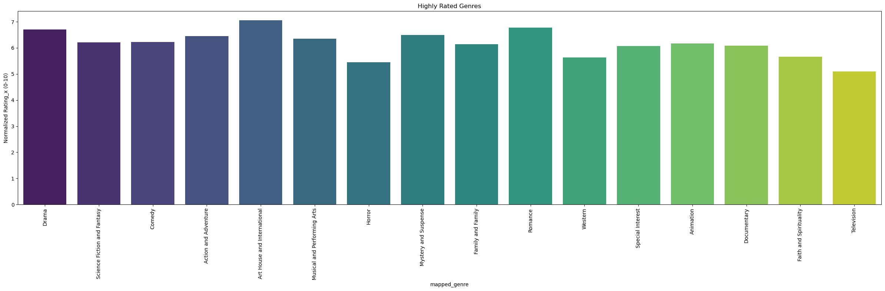
1.Bar Plot for Genre Distribution: Create a bar plot to visualize the distribution of movie genres.

Slide 9
Conti…
The barplot illustrates the distribution of movie ratings across different movie genres which gives gives insights on the most favoured movies.
Action & Adventure, Art House & International, Drama, Romance, Documentary/Musical & Perfoming Arts are the top rated movie genres suggeting the diversity in audince preference.
Action, Romance, Art, Documentary, Musical and Perfoming Arts present an opportunity for Microsoft to delve into the industry as their ratings represents populairity among consumers

Slide 10
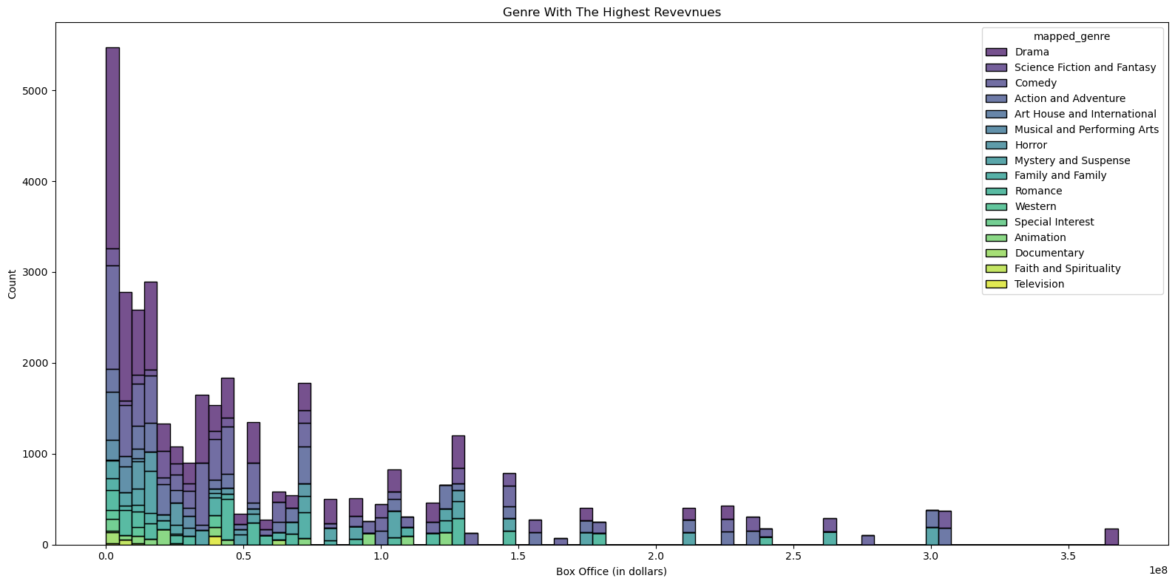
Histogram to Represent Revenue Distribution against Genres

Slide 11
Conti…
Our visualized data show the movie genres with the highest income revenue.
The highest income earners from the data are Drama, Comedy, Science Fiction and Fantasy.
Action and Adventure too are amongst the top income earners. This poses a perfect avenue for the company to dive into the movie production industry.

Slide 12
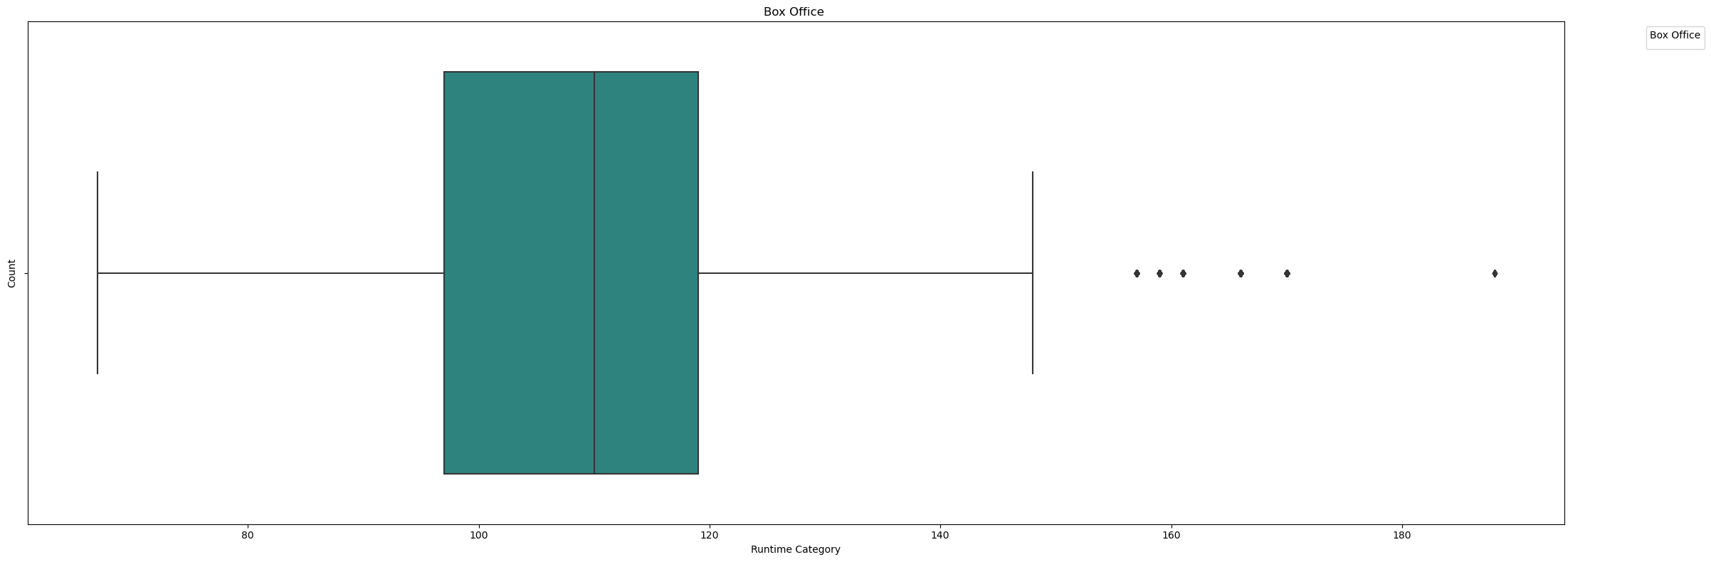
Boxplot representing movie revenues and movie Runtime.

Slide 13
CONTI…
Insight. The movie runtiime that generates the highestincome ranges from slightly below a hundred mins to slightly below 120 minutes. Although there may be outliers in the data, a huge chunk of the movies that ranges from slightly 100 mins to slightly below 120 mins.

Slide 14
Step 5 Conclusions:
Genre Anlysis: From the analysis, the best and top rated movies fall under Drama, Romance, Art House and International, Mystery and Suspense and Action& Adventure genres
Ratings Analysis: The most preffered movies fall under Drama and Art House and International as they are the top rated movies from our analysis.
Financial Analysis: We an determine the movie genres with the highest income generated from our analysis as Drama, Comedy, Science Fiction and Fantasy. These are the movies exihibiting robust gross income in total
Strategic Understanding: The data offers practical insights for Microsoft's movie studio to make well-informed decisions regarding genre selection, content strategy, and audience targeting.

Slide 15
Recommendations:
Genre Creativity: The company should focus on high performing genres. While certain genres are prevalent, there's room for novelty and experimentation in genre selection. Microsoft's movie studio can explore unique genre combinations to distinguish its offerings and attract new audience segments.
Consider Audience Preferences: Examine the distribution of genres to align movie production with popular audience tastes while also exploring creative genre combinations for differentiation.

Slide 16
CONTI…
Diversify Genre Portfolio: While Drama and Art House and International dominate the market, explore opportunities in niche genres such as Romance, and Science Fiction and Fantasy to cater to diverse audience preferences.

